Slide 1

Inference-Time Scaling for Generalist Reward Modeling
Raheel Nazir 21l-6283
Mashhood Husnain 21l-5651
Umer Tariq 21l-7696
Saif Aziz 21l-6250

Slide 2

Introduction
Goal: Create generalist reward models (RMs) that scale with inference-time compute.
Scalar RMs can’t use sampling or critique
Domain-specific RMs don’t generalize well]
Key Idea: Generate textual principles and critiques, then extract numeric scores
Contributions:
Self-Principled Critique Tuning(SPCT) - new training method
Inference-Time Scaling - Improves accuracy with sampling and meta-voting

Slide 3
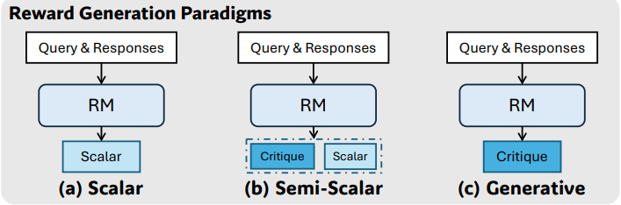
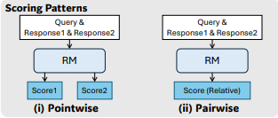
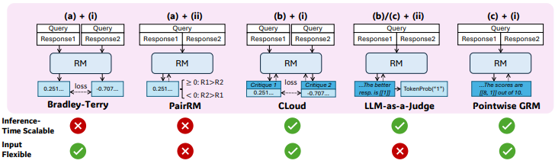
Preliminaries
Pointwise Generative Reward Modeling (GRM):
Input: Query + multiple responses.
Output: Generated principles → critique → numeric scores for each response.
Score Extraction:
From generated critique, extract a score (e.g. 1–10) for each response.
Advantages of GRM:
Works for single, pairwise, or multiple responses.
Enables inference-time sampling and critique diversity.
Contrast with Scalar RMs:
Scalar RMs output a number directly, no room for reasoning.
GRM supports richer interpretability and scaling.

Slide 4
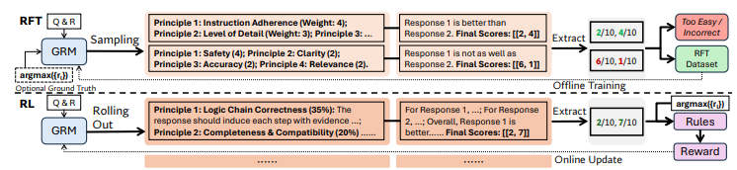
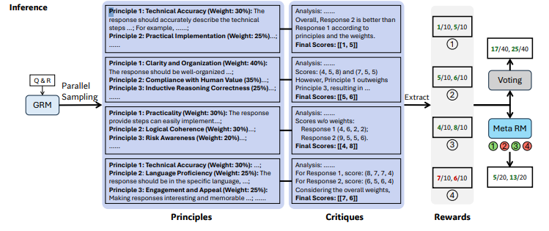


Self-Principled Critique Tuning (SPCT)
A training method for Generalist Reward Models (GRMs), that teaches models to generate evaluation principles and use them to critique responses.
Rejective Fine-Tuning
Rule-Based Reinforcement Learning

Slide 5
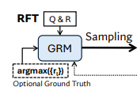

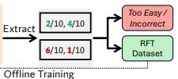
Self-Principled Critique Tuning (SPCT)
Phase 1: Rejective Fine-Tuning (RFT)
GRM learns to:
Generate principles (e.g., “Clarity: 30%”, “Safety: 20
Write critiques based on these principles.
Bad training examples are rejected if:
Scores don’t match ground truth
Task is too easy (all scores correct by default).

Slide 6



Self-Principled Critique Tuning (SPCT)
Phase 2: Rule-Based Online RL
GRM is rewarded if:
It picks the best response (according to ground truth).
Its self-generated critique matches rule-based correctness.
KL penalty ensures output format consistency.

Slide 7
Inference-Time Scaling Strategies
Improve reward modeling accuracy at inference using sampling-based voting and Meta Reward Modeling
Voting with Generated Rewards
Generate multiple principles and critiques per response.
Final score:
Captures diverse judgment perspectives.
Expands score granularity.
Shuffling avoids positional bias.
More critique samples → better approximates the true distribution of quality judgments.

Slide 8
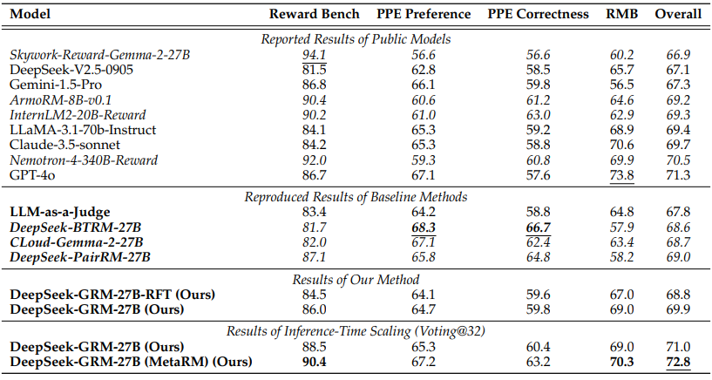
Inference-Time Scaling Strategies
Meta Reward Modeling
Trained scalar RM evaluates critique correctness
Filters out low-quality critiques before voting.
Uses both non-hinted RFT samples & DeepSeek-generated samples.
Performance Highlights of DeepSeek-GRM-27B (Meta RM):
Reward Bench: 90.4 PPE-Preference: 67.2
PPE-Correctness: 63.2 RMB: 70.3
Overall: 72.8 (best among all tested models)
Meta-guided voting at inference time significantly boosts reward modeling performance—outperforming even GPT-4o.

Slide 9
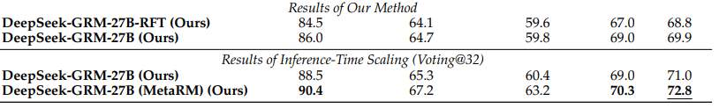
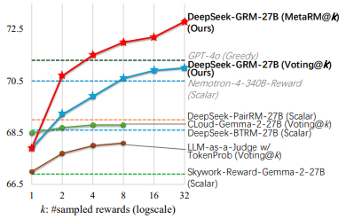
Benchmark Results: Big Picture
DeepSeek‑GRM‑27B (greedy) sits at 69.9 overall accuracy across Reward Bench, PPE & RMB
Simple Voting@32 already lifts the same 27 B model to 71.0 (+1.1 pp)
Meta RM + Voting@32 delivers the knockout: 72.8 overall — above GPT‑4o (71.3) and Nematron‑340B (70.5) despite 10‑25× fewer parameters .
X‑axis is log‑scaled k (number of reward samples); Y‑axis is aggregate accuracy.
Up to 8 samples: +2.7 pp; 32 samples: +3.1 pp (plain voting) or +4.9 pp with Meta RM .
Curve flattens ≈ 32 — good place to cap compute in real‑time systems.

Slide 10
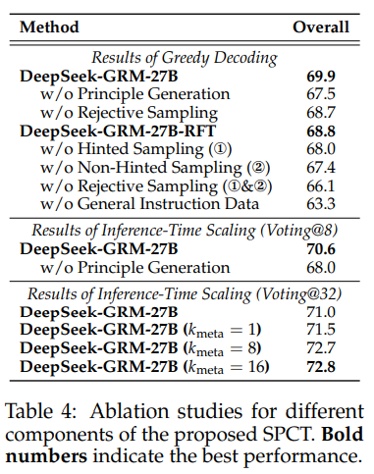
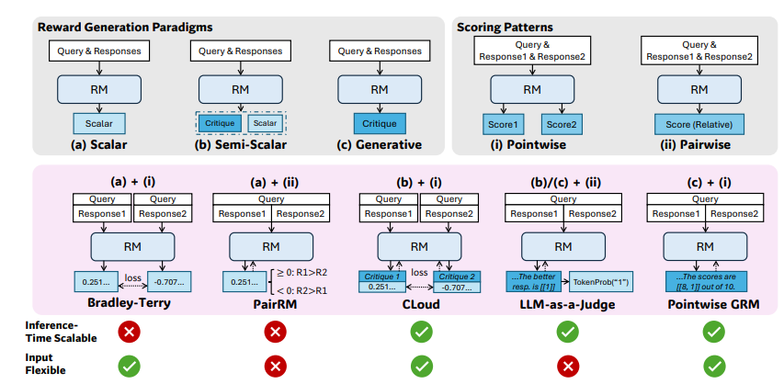

SPCT Matters!
No principle generation → –2.4 pp (69.9 → 67.5). Principles drive granular, domain‑aware judging .
Skip rejective fine‑tuning → –1.2 pp; the cold start helps format & task generalisation.
Drop general instruction data → –6.6 pp (!) — shows base knowledge still crucial.
Scalar RMs: fast, deterministic; shine on verifiable maths/coding but can’t sample → poor scaling (e.g., DeepSeek‑BTRM) .
Semi‑Scalar: adds critiques but reward still fixed; limited variance (CLoud‑Gemma).
Generative + SPCT: text‑only reward ➜ flexible inputs and high variance, perfect for sampling.
Parallel trend: inference‑time scaling papers (“Large‑Language‑Monkeys”, “Let’s Verify Step by Step”) focus on policy models. Our work brings the same idea to reward models.

Slide 11
Conclusion
Compute‑efficient edge: 27 B @ 32 samples ≈ 671 B greedy .
SPCT trains the model to invent principles + critiques on the fly → higher fidelity rewards.
Meta RM shows that smart filtering > brute‑force sampling.
Future directions: plug GRM into live RL loops; study bias mitigation; co‑scale policies and rewards for end‑to‑end gains .

